Slide 1
Environmental Control System Door Redesign
Timothy Anderson, Andrea Hernandez, Sam Mangialardi, Alexander Soto, Jake West, Michael Wilson
PDR
Preliminary Design Review
November 12, 2020
Figure 1: Antares Rocket [1]

Slide 2
Outline
Section 1: Project Intro to QFD
Section 2: Concept Generation and Evaluation
Section 3: Final Design, CAD Models, and Analyses
Section 4: Budget and Future Work

Slide 3
Section 1:
Project Intro to QFD

Slide 4
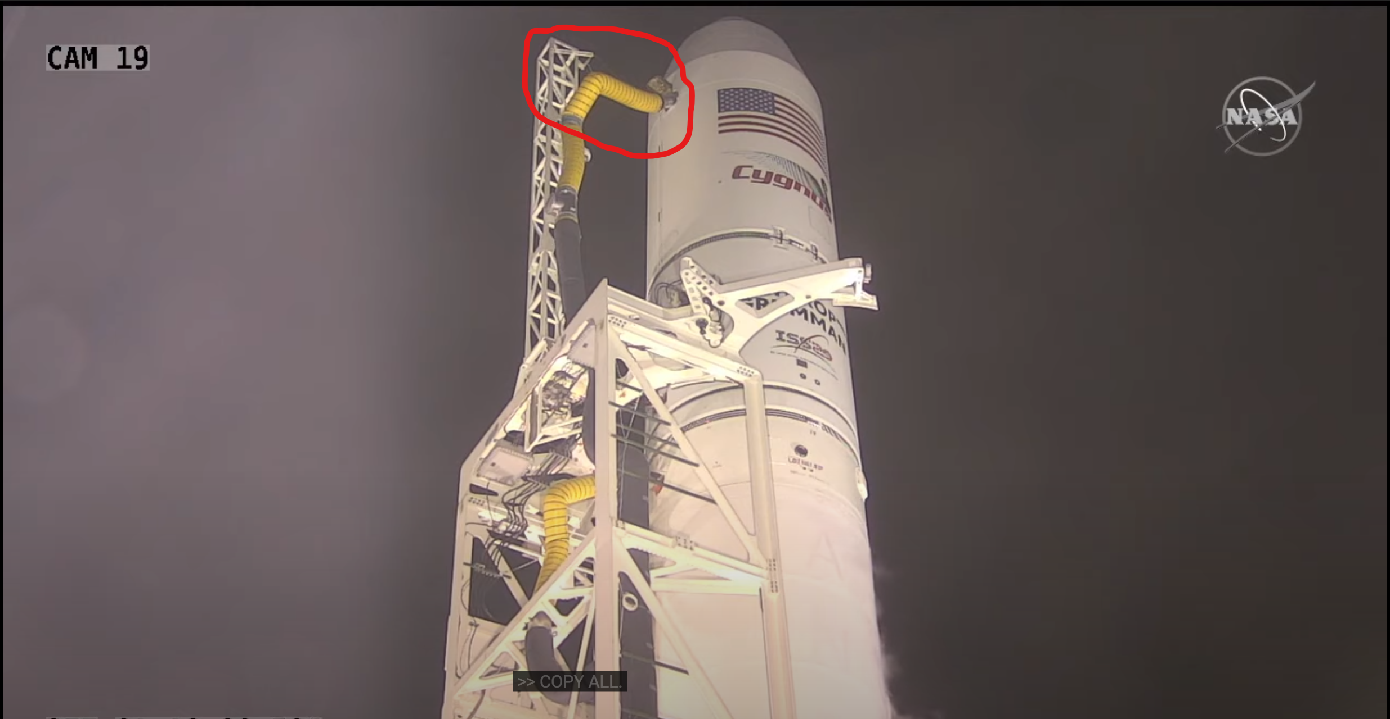
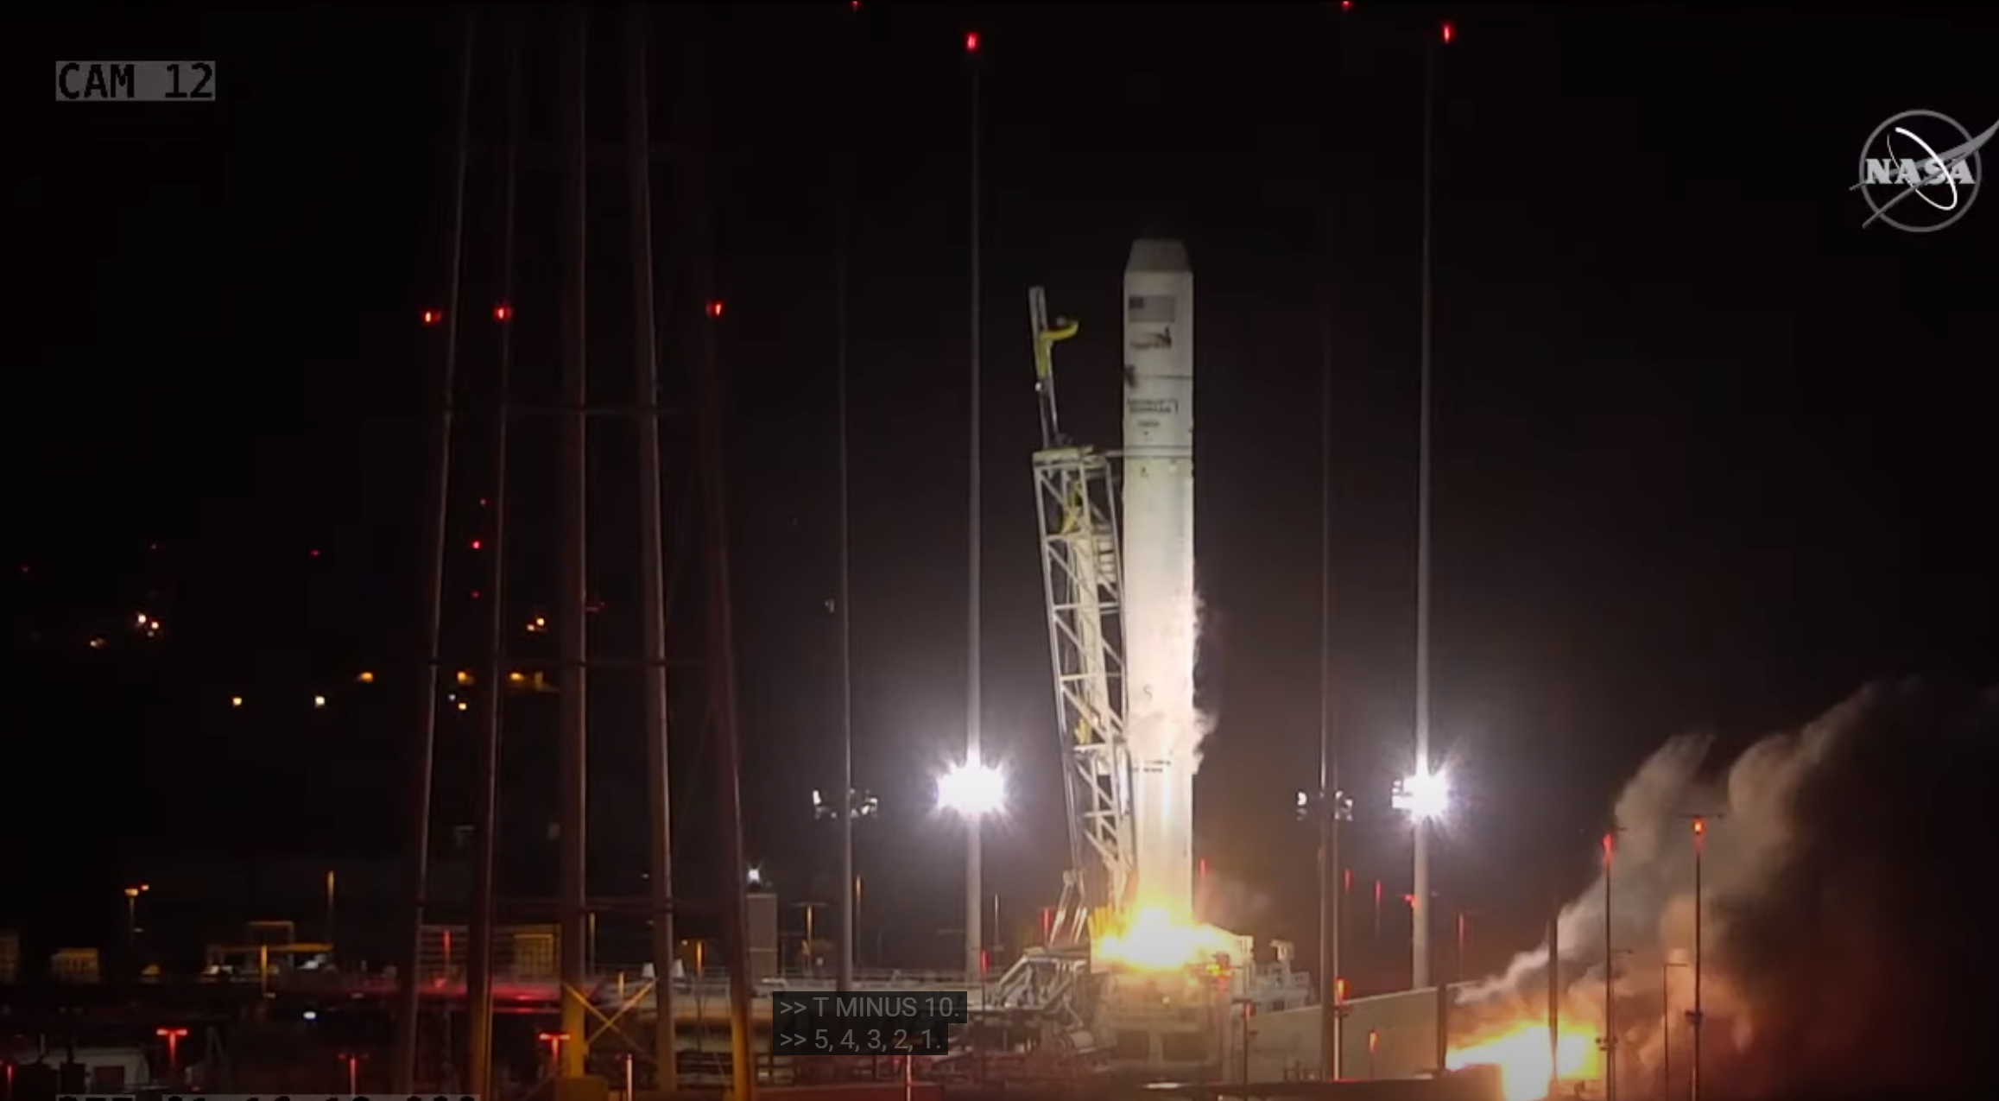
Project Intro
Improve the latching system for the Antares rocket.
Our objective is to investigate potential failures of the door.
Excessive leakage of air could lead to potential failure. ​
A successful design could be implemented into other launch vehicles.
Figure 2: Nozzle in place [2]
Figure 3: Nozzle is removed [2]

Slide 5
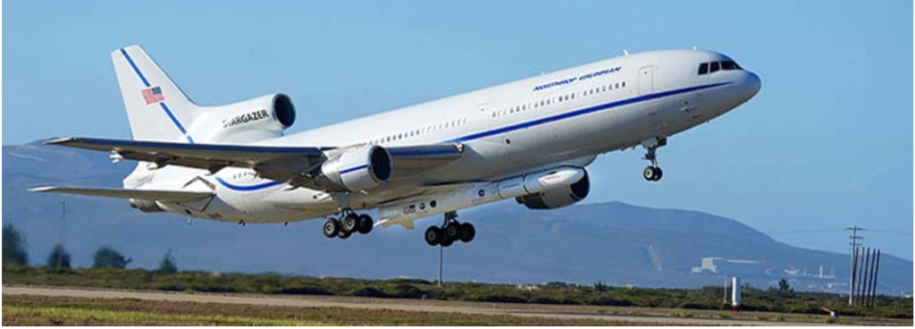
Background of Heritage Design
Velcro was bonded on.
Closed with force of torsion spring.
Easily scalable.
Easy to reopen.
Figure 4: Pegasus Rocket [3]

Slide 6
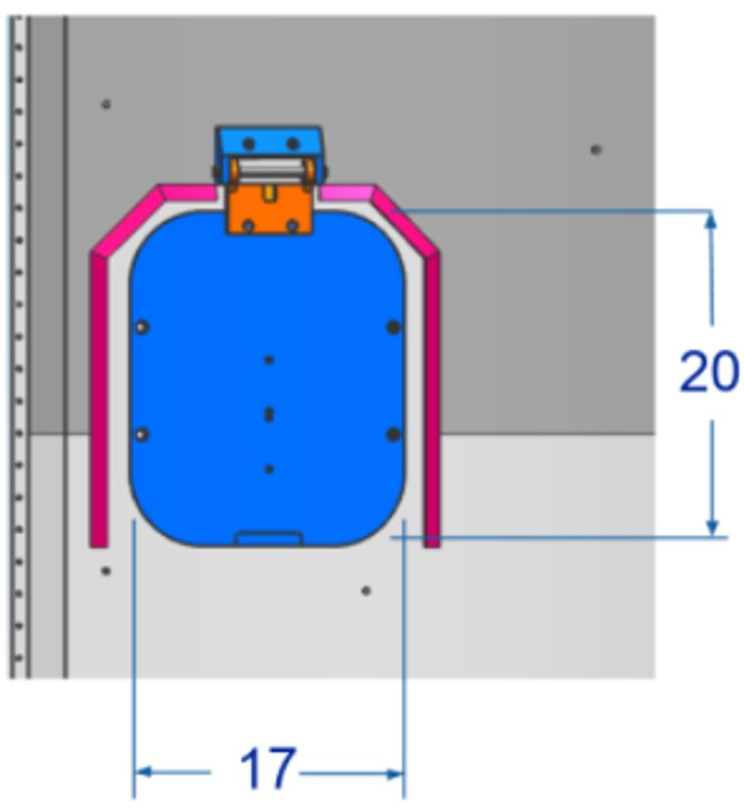
Heritage Design Flaws
The design did not withstand pressure differential.
The latching system was unsuccessful in flight.
The design is unpredictable.
Figure 5: Heritage Design

Slide 7
Customer Requirements
Ease/Safety Of Installation​
Installation must be safe and manageable without the use of uncommon, specialized tooling.​
Scalable​
Design must be able to be scaled for use on various sized Northrop Grumman vehicles.​
Reopenable​
Door must be able to easily open without specialized tooling in case of accidental closure prior to launch.​
Withstand Pressure Differential ​
Design must be able to withstand pressure differential to prevent opening during flight.

Slide 8
Customer Requirements Cont.
No Contaminates​
Materials must not generate any foreign object debris(FOD) such as shavings, sparks, dust, off gassing, etc.​
Not Based on Gravity​
Design must not rely solely on gravity or acceleration of vehicle to close during launch.​
Door Closes On Launch​
Design must automatically close upon launch of the vehicle when the ECS nozzle is removed.​
No Interference With Nearby Systems​
Design must not interfere with nearby satellite systems or operation of vehicle fairings.

Slide 9
Customer Requirements Cont.
Professionalism​
Team must provide a high standard of professional work and communication.​
Minimum Effect on Aerodynamics​
Design must be externally flat to prevent aerodynamic changes to vehicle.​
Electrostatic Discharge Safe​
Design materials must not cause sudden electrostatic discharge to protect sensitive electronic circuits nearby.​
Stretch Goal: Door Status Indicator​
Design remotely indicates status of door as open or closed.​

Slide 10
Customer Requirements Cont.
Table 1: Rated Customer Requirements
The level of importance was determined by a rating from 1-10. ​
Priority: ​
Pressure differential ​
Activates on launch characteristics​
No interference with nearby systems​
Nice to have:​
Indicate Open/Closed status.​
​
# | Customer Requirement | Rating
1 | Ease/safety of installation | 7
2 | Scalable | 8
3 | Reopenable | 4
4 | Withstand pressure differential | 10
5 | No contaminates | 8
6 | Does not use gravity or acceleration | 6
7 | Activates on launch | 10
8 | Does not interfere with nearby systems | 9
9 | Professionalism | 5
10 | Does not influence aerodynamics | 9
11 | ESD safe | 7
12 | Indicates open/close status | 1

Slide 11
Engineering Requirements
Table 2: Listed Engineering Requirements
Provided by Northrop Grumman project proposal
High standard of design performance, reliability, durability, and safety
Quantitative Requirements
Engineering Requirement | Limiting Value
Safety Factor | Metallic: 1.6 yield and 2.0 for ultimate Plastic or composite: 2.0 ultimate and 2.3 for buckling
Vibrations | 73 Gs
Pressure differential | 7.5 psi
Budget | $8,000
Dimensions | Inlet Area: 203 in^2
Weight | 5 lbm
Pressure Limit on Fairing | 810 psi

Slide 12
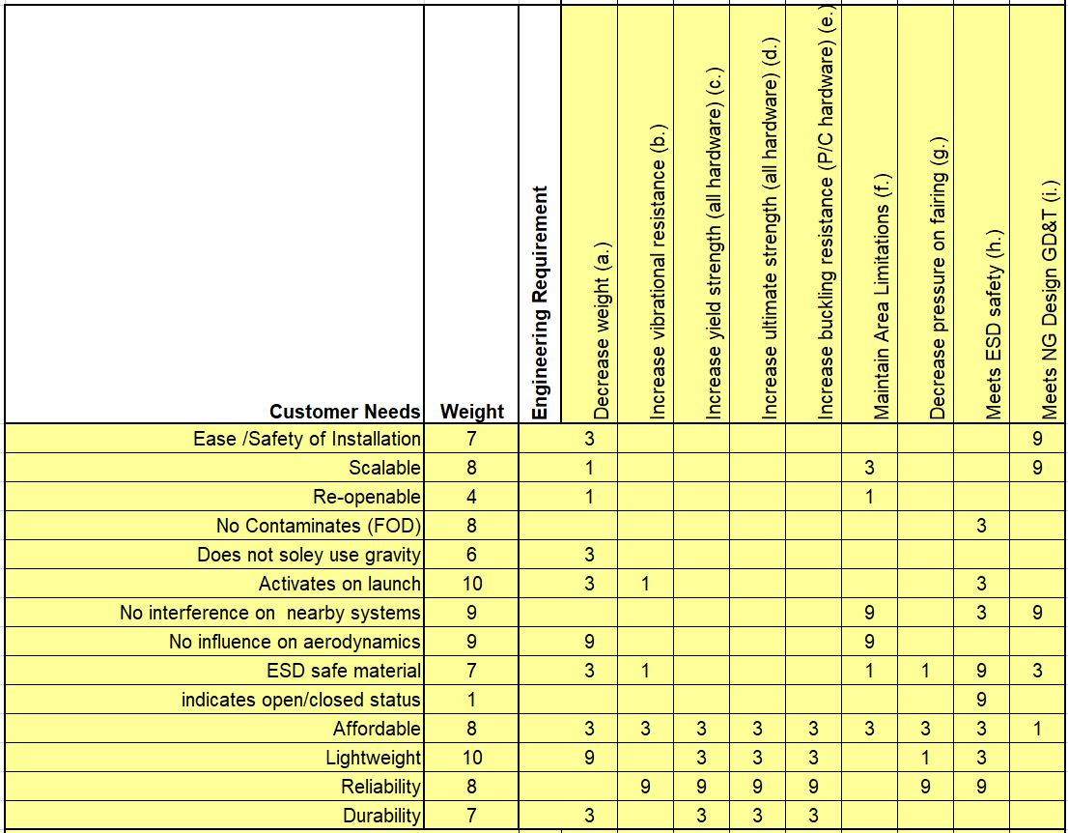
QFD
Table 3: QFD CR’s vs ER’s

Slide 13
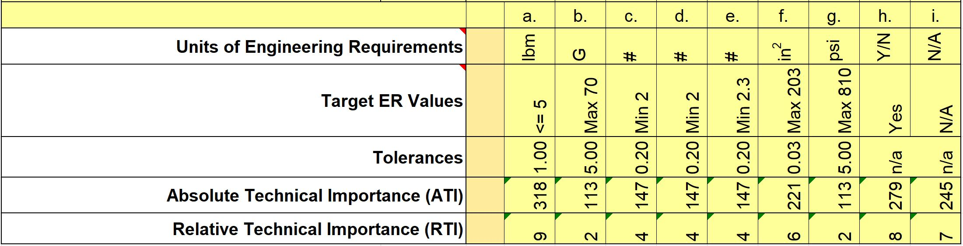
QFD Cont.
Results show that weight has the greatest impact on CR’s and ER’s.
Minimizing pressure on the fairing shows to have the least impact.
Table 4: QFD Results

Slide 14
Section 2:
Concept Generation and Evaluation

Slide 15
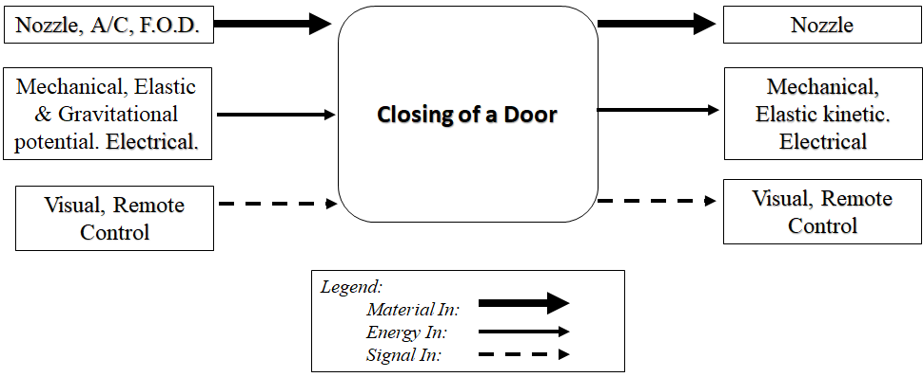
Black Box Model
Figure 5: Black Box Model
Four subsystems:
Latching mechanism
Dynamic Movement
Fail Safe
Nozzle Design

Slide 16
Functional Model
Table 5: Functional Model Basis Functions
Detailed sub-functions of flow inputs and outputs.
Customer requirement’s checklist for potential solution designs.
Notes:
The division gives emphasis on how functions will be achieved throughout the use of the design and the results of the material, energy, or signal flow path. And any dependencies of sub systems
*overall:supports designers reasoning

Slide 17
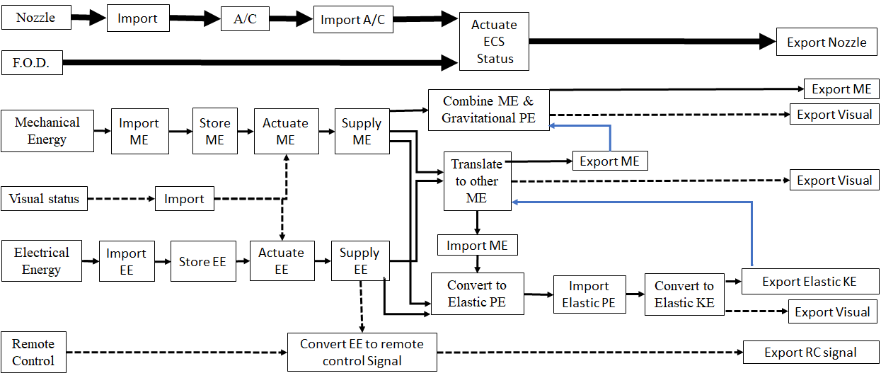
Functional Decomposition Model
Figure 6: FDM to actuate a door.
Notes:
Functional model here is a visual of the inter related work of the input flows from black box model and the actions from the Functional Model Basis Functions
The goal here is to cause the ECS door to operate/function ( successfully)
The goal here is to actuate the ECS door

Slide 18
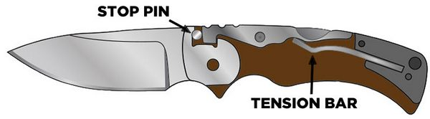
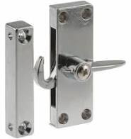
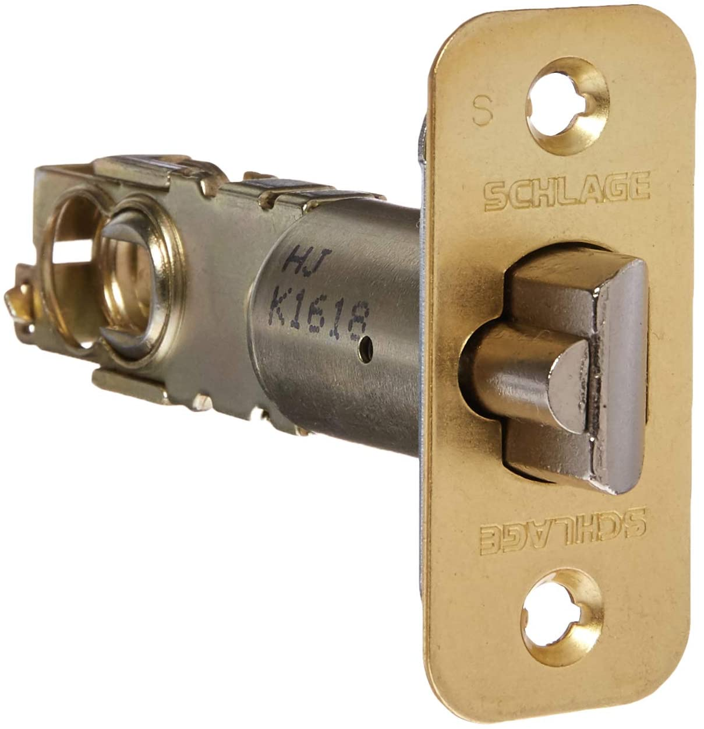
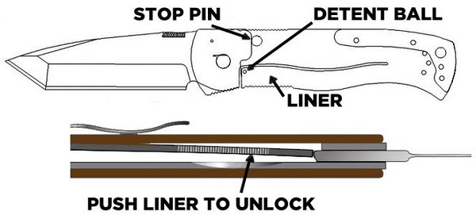
Subsystem #1: Latch
Pocket knife locking mechanism
Door spring loaded mechanism
Velcro
Cabinet latching
Figure 7: Screen door hook
Figure 8: Deadlatch /mortise locks
Figure 9: Tri-Ad Lock and Liner lock
Notes:
Brainstorming, concept generation

Slide 19
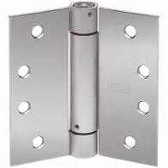
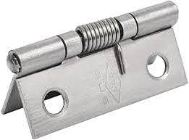
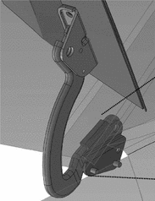
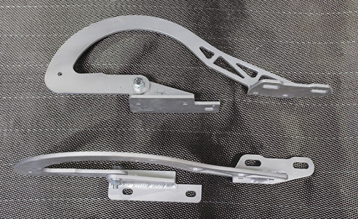
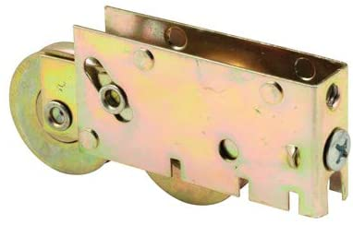
Subsystem #2: Hinge
External door with torsional spring
Internal car hood hinges
Sliding door with bearings
Figure 10: Spring loaded hinges
Figure 11: Bonnet Hinges
Figure 12: Door roller
Notes:
Brainstorming, concept generation

Slide 20
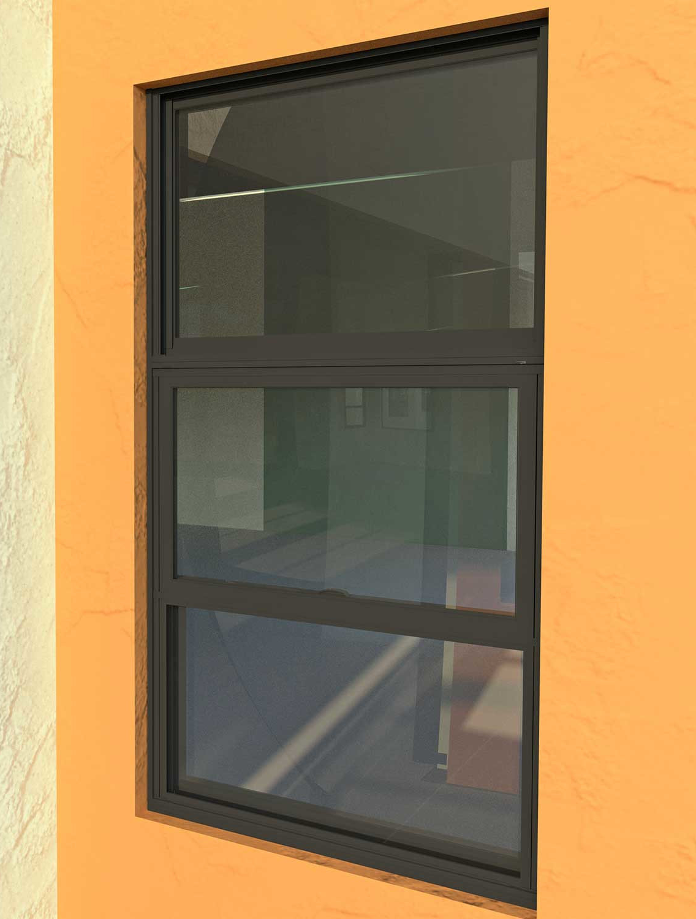
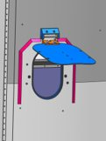
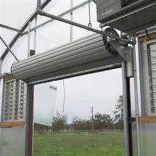
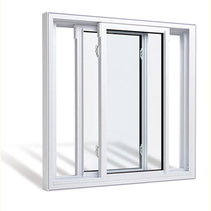
Subsystem #3: Dynamic Movement
Sliding down
Swinging 90,180 degrees
Rolling
Lateral sliding
Figure 13: Single hung door
Figure 14: Single hung door
Figure 15: Rolling door
Figure 16: Dual sliding
Notes:
Brainstorming, concept generation

Slide 21
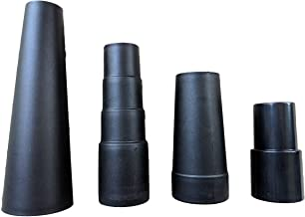
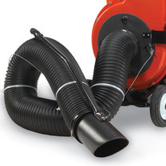
Subsystem #4: Nozzle Design
Original Design
Custom Design
Figure 18: Vacuum Hose Attachments
Figure 17: Basic Nozzle Design

Slide 22
Concept Generation
Visual concepts were generated using a morph matrix.
Four sub-systems were generated and populated with basic sketches.
Sketches derived from door hinges, cabinet locks, car hood latches, etc.
Top four were made in CAD.

Slide 23

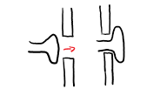

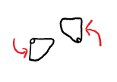
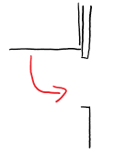
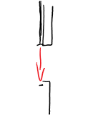
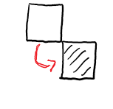
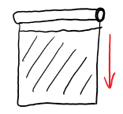
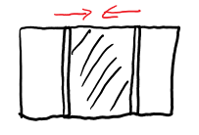
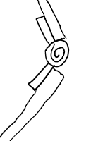
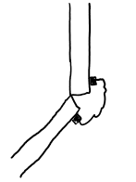
Morph Matrix
Table 6: Morphological Matrix
Latch
Dynamic Movement
Hinge
Nozzle Design | Standard Design | Custom Design

Slide 24
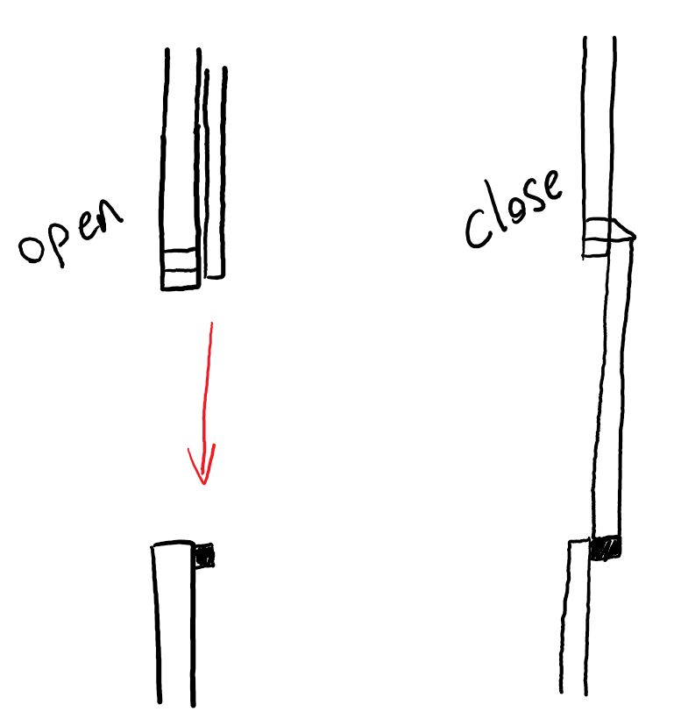
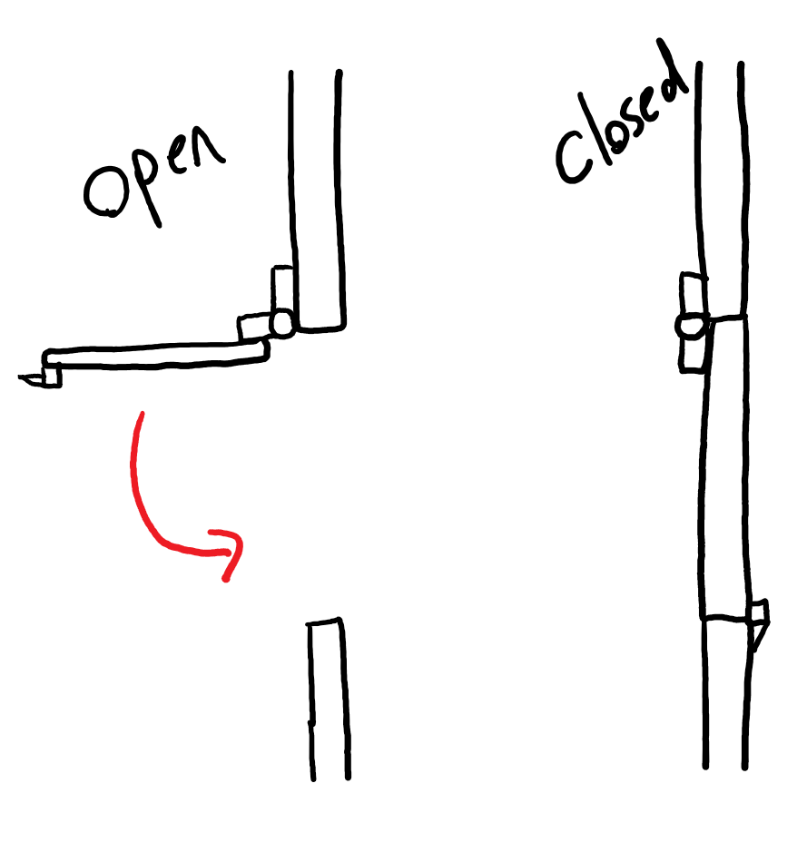
Designs
Design 1: Sliding Door
Advantages: Unique design, Hugs tight to interior
Disadvantages: Depends on gravity, maintaining a tight seal
Design 2: Exterior Door Hinge
Advantages: Simple design, easy to scale up or down
Disadvantages: Vibrations might cause unlatching, strong latch required

Slide 25
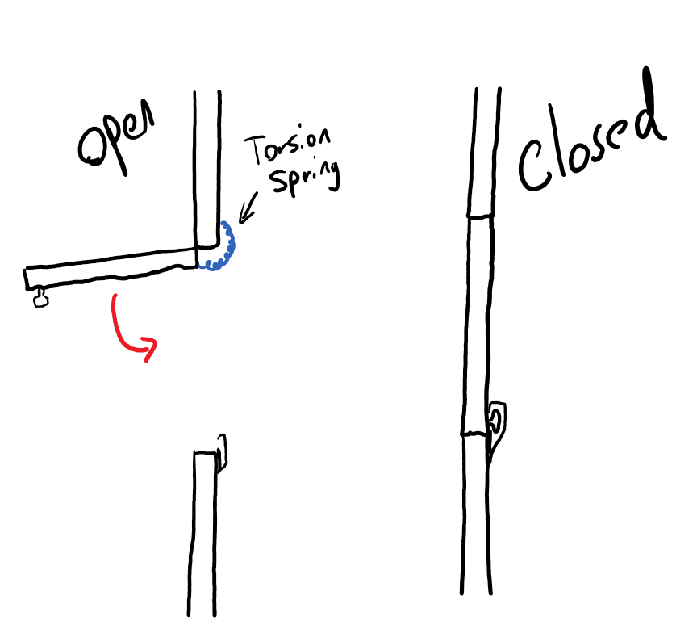
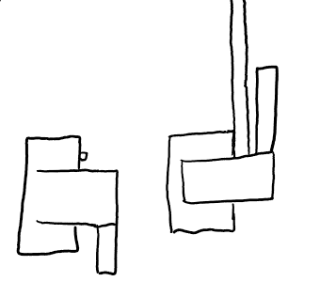
Designs
Design 3: Interior Door Hinge
Advantages: Flush with exterior of rocket, simple latching mechanism
Disadvantages: Vibrations might cause unlatching, bulky hinge mechanism
Design 4: Twisting latching
Advantages: Scalable and lightweight, tight seal on door
Disadvantages: Possible aerodynamic drag, intricate design

Slide 26
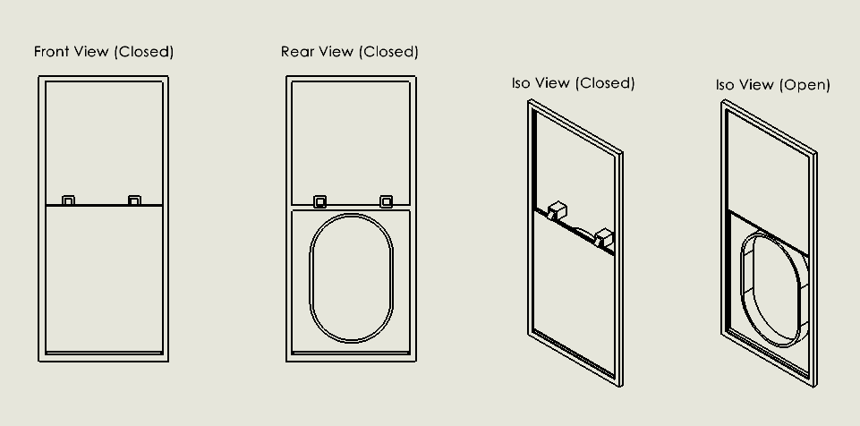
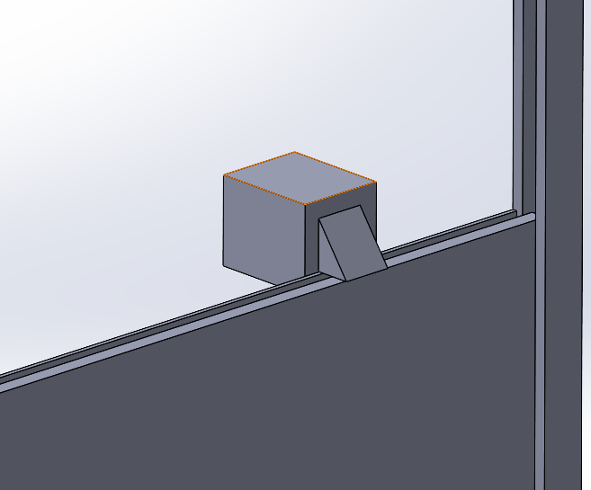
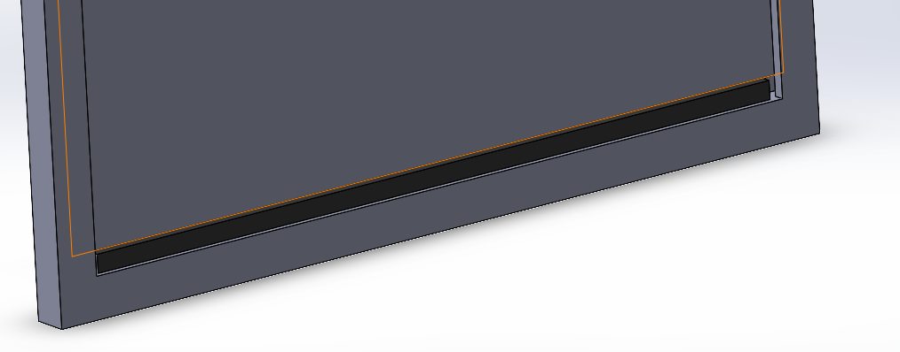
Sliding Door Design
Closes as nozzle is removed.
Spring powered angled latch secures the door.
Door is sealed by bumper, and brush.
Figure 19: Sliding Door Views
Figure 20: Rubber Bumper
Figure 21: Sliding Door Latch

Slide 27
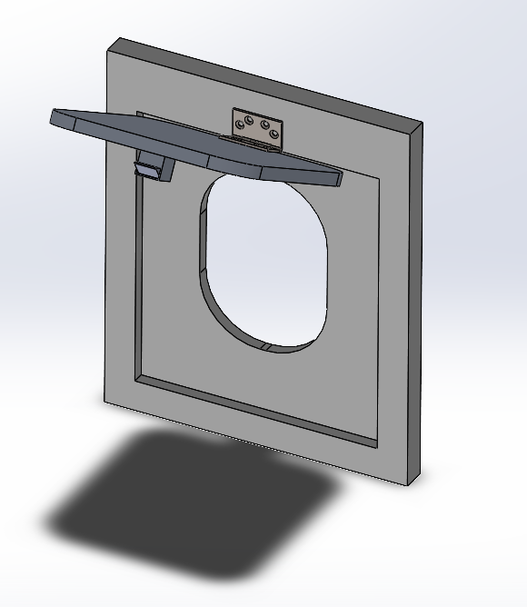
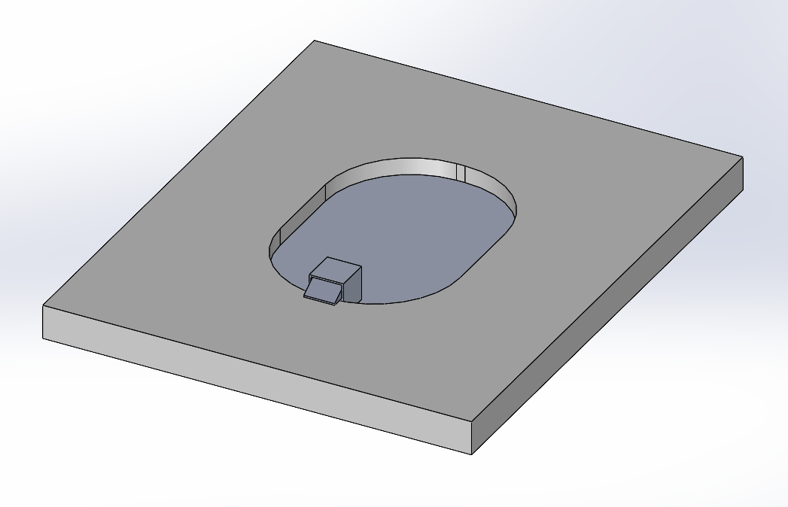
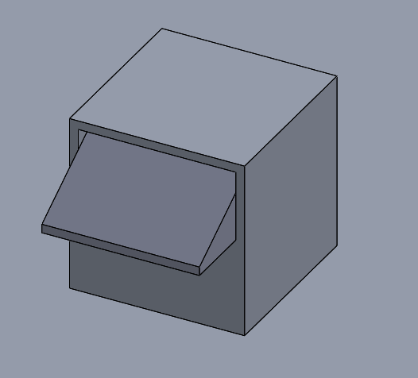
Exterior Hinge Design
Exterior door closes as the nozzle is removed at launch.
Closed by the hinge torsional spring forcing the angled latch to hook onto edge.
Secured by fitted tolerances
(b) Exterior Hinge Closed
Figure 22: (a) Exterior Hinge Open
(c) Angled Latch

Slide 28
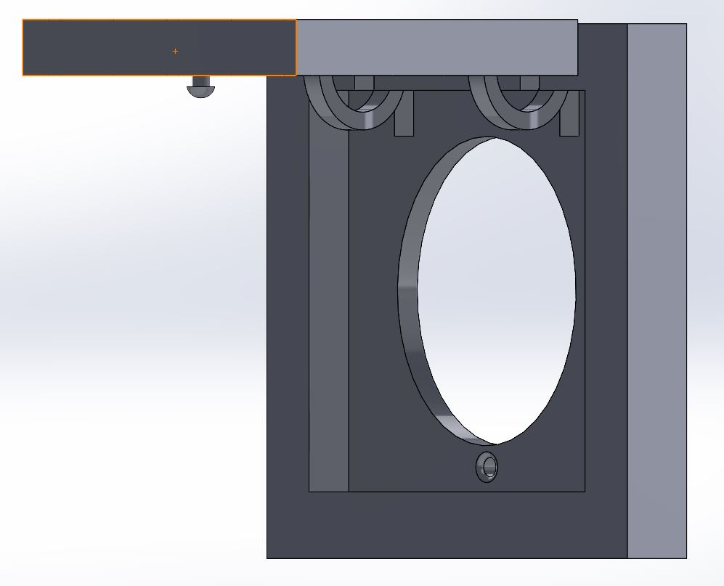
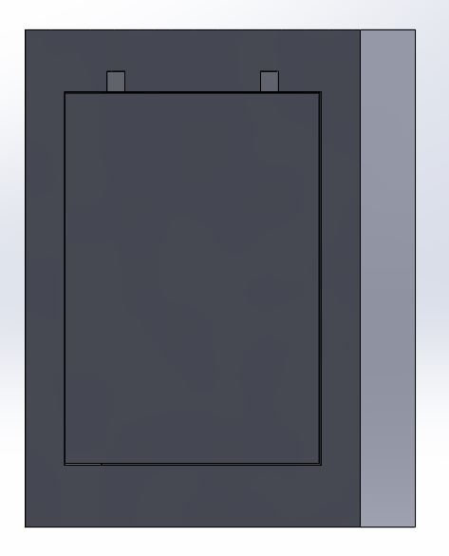
Interior Hinge Design
Interior hinge creates a flush exterior face.
Internal torsion springs close door after nozzle removal.
Rounded knob latching system locks with closing force of door.
Figure 23: (a) Open Door View
(b) Closed Door View

Slide 29
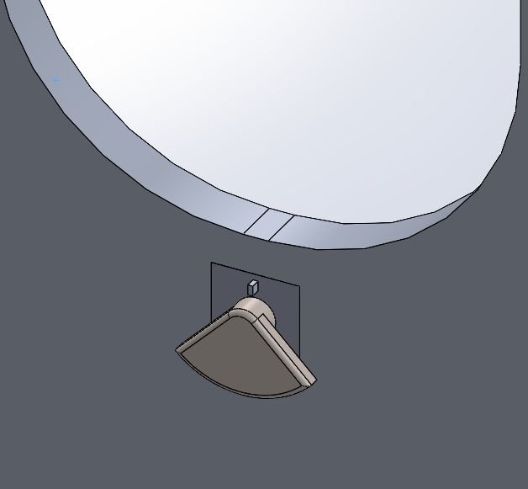
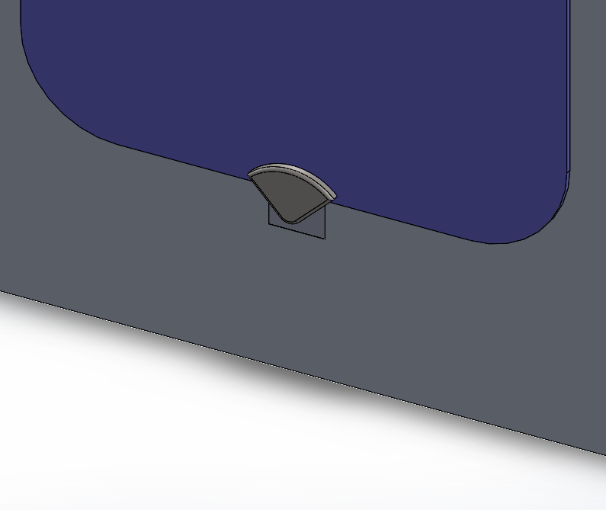
Twisting Latch Design
Uses exterior hinge design, with a solid aluminum door.
Latching system activates as the door hits the fairing.
Latch twists 180 degrees until it locks down the door to the fairing.
The design can be reopenable by hand, by turning the latch counterclockwise with enough force to overcome the torsion spring.
Figure 24: (a) Open Door View
(b) Closed Door View

Slide 30
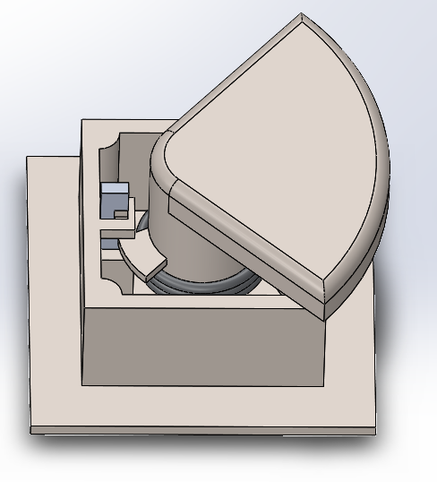
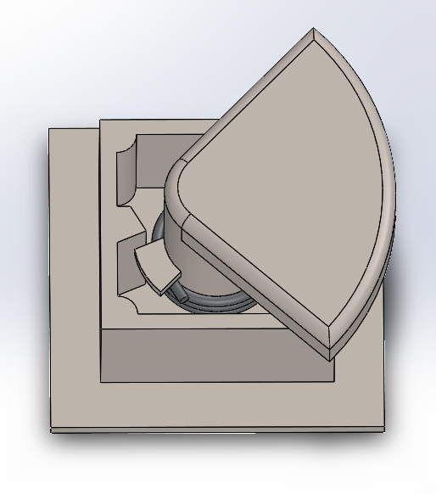
Twisting Latch Design Cont.
In open position, latch is held in place by a pin.
The pin gets compressed by the closing door, unlocking the latch, allowing the torsion spring to allow the latch to spin over the top of the door.
The entire latch is held within a steel housing that will fit into the vehicles fairing.
Figure 31: Open Latch Internal View
Figure 32: Closed Latch Internal View

Slide 31

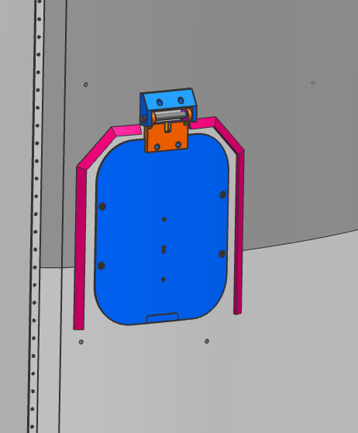
Concept Evaluation
Table 6: Pugh Chart
Selection Criteria | Weight | DATUM | Concepts
 |  |  | 1 | 2 | 3 | 4
Ease/Safety of Installation | 7 |  | - | S | - | -
Scalable | 8 |  | S | S | S | +
Reopenable | 4 |  | - | S | S | S
Withstand Pressure Differential | 10 |  | + | + | + | +
No contaminates | 8 |  | - | S | S | +
Does not use gravity | 6 |  | - | S | S | S
Activates on launch | 10 |  | S | S | S | S
Does not interfere with nearby systems | 9 |  | - | S | + | S
Professionalism | 5 |  | S | S | S | S
Does not influence aerodynamics | 9 |  | - | S | + | -
ESD Safe | 7 |  | - | S | S | S
Indicates open/closed status | 1 |  | S | S | S | +
Total (+) |  |  | 1 | 1 | 3 | 4
Total (-) |  |  | 7 | 0 | 1 | 2
Overall Score |  |  | -6 | 1 | 2 | 2
Weighted Total (+) |  |  | 10 | 10 | 28 | 27
Figure 33: Datum Opened
Figure 34: Datum Closed
Notes:
Pugh chart to compare the 3 previous designs
Sliding /exterior /interior hinge/ twisting latch
Quantitative approach
Datum: current design used on the rocket

Slide 32
Concept Evaluation Cont.
Table 7: Decision Matrix
 |  | Sliding Door |  | Exterior Hinge |  | Interior Hinge |  | Twisting Latch
Criteria | Weight (%) | Score (1-10) | Weighted Score | Score (1-10) | Weighted Score | Score (1-10) | Weighted Score | Score (1-10) | Weighted Score
Safety Factor | 12 | 7 | 84 | 7 | 84 | 6 | 72 | 8 | 96
Vibrations | 16 | 8 | 128 | 7 | 112 | 4 | 64 | 7 | 112
Pressure Differential | 20 | 7 | 140 | 8 | 160 | 7 | 140 | 9 | 180
Budget | 8 | 3 | 24 | 9 | 72 | 7 | 56 | 9 | 72
Dimensions | 14 | 4 | 56 | 8 | 112 | 9 | 126 | 8 | 112
Weight | 10 | 2 | 20 | 9 | 90 | 7 | 70 | 9 | 90
Crush Rating of Design | 20 | 6 | 120 | 7 | 140 | 7 | 140 | 7 | 140
Totals | 100 |  | 572 |  | 770 |  | 668 |  | 802
Notes:
finalized a consensus on the criteria to analyze. Determined the weighted values (12 16 20 etc.)
then scored each design in a QUANTITATIVE manner in relation to
safety 1.6 Yield min, 2 for Ult, for metallic hardware. And composite: 2 ult min and 2.3 buckling min
vibrational effects 70Gs
pressure limitations considerations: 7.5psi in flight and 810psi compressive stress
Dimensions 203in^2 max
total cost/budget$8000
Feasibility to back up the decisions
Weak aspects...
Brainstormed how /if weak points could be improved
from our top 3 designs they ultimately were ranked x=1 y=2 z=3

Slide 33
Section 3:
Final Design/CAD Models/Analyses

Slide 34
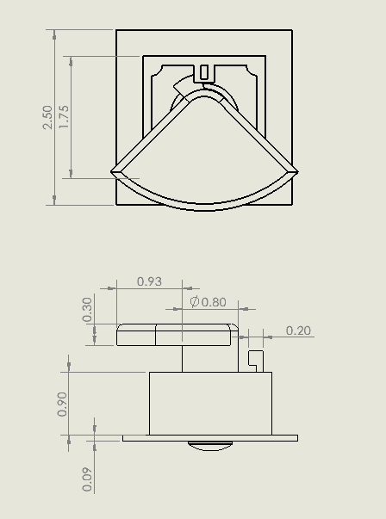

Top Design: Twisting Latch
Fast Latching System
Lightweight Design
Minimal need to change other systems.
Pulls the door closer to the fairing.
Can be used implemented in multiple locations.
Figure 35: Latch Housing
Figure 36: Twisting Latch Dimensions

Slide 35



Final Design – open position
Open position while ECS Nozzle rests in inlet.
Latch is spring loaded, held in place by steel pin, preventing rotation.
Figure 37: Open Position
Figure 38: Open Position Internal
Figure 39: Bottom View

Slide 36



Final Design - activation
Figure 41: Open Latch Section View
Figure 42: Section View Activation
Figure 43: Closed Latch Section View
Once the pin is activated, the loaded torsion spring will rotate the latch piece.
8 threads per inch results in the latch lowering 0.0625 inches in 180 degrees.

Slide 37

Full System Activation
Figure 43: Animation

Slide 38

Latching System Activation
Figure 44: Interior Animation

Slide 39



Final Design – latched position
Latch is now over the top of the door, preventing door movement
Threads are in tension, friction of the threads prevents rotation
Figure 45: Closed Position
Figure 46:Internal Closed View
Figure 47: Lower Closed View

Slide 40

Material Analysis
AISI 304 Stainless Steel
Corrosion Resistance
Commonly available and manufactured
Ultimate tensile Strength: 73,200psi [7]
Ultimate Yield Strength: 31,200psi [7]
Common Uses:
Food Processing Equipment, Heat Exchangers, Automotive and Aerospace structural use
Figure 48: AISI 304 Stainless Steel

Slide 41

Weight Analysis
Table 8: Weight Analysis
Material | Part
Housing | AISI 304 Steel
Shaft | AISI 304 Steel
Bolt | AISI 304 Steel
Bottom Plate | AISI 304 Steel
Top Plate | AISI 304 Steel
Pin | AISI 304 Steel
Compression Spring | Music Wire ASTM A228
Torsion Spring | Music Wire ASTM A228
Mass Properties | Twisting Latch
Surface Area | 54.06 ${in}^{2}$
Volume | 3.33 ${in}^{3}$
Mass | 0.96 $lb$
With the selected materials the whole system weighs 0.96 lb.
A low weight allows the system to be scaled up if needed.

Slide 42



Thickness of Latch Analysis
Latch Thickness= .3in
Factor of Safety, Yield = 1.65
Factor of Safety, Ultimate= 3.89
Table 9: Latch Analysis [4]
AISI 304 Stainless Steel
Tensile Strength, Yeild
31,200 psi
Tensile Strength, Ult
73,200psi
Figure 49: Cantilever Beam Representing Latch

Slide 43
Torsion Spring Analysis
Table 10: Torsion Spring Dimensions
Table 11: Torsion Spring Design
Torsion Spring Dimensions
Wire Material | Music Wire ASTM A228
A [kpsi*in^m] | 201
m | 0.145
Wire diameter [in] | 0.08
Outside Diameter [in] | 0.98
# of Coils | 4
Pin Diameter [in] | 0.8
Leg Length #1 [in] | 0.5
Leg Length #2 [in] | 0.4
Torsion Spring Design Parameters
Sut [kpsi] | 289.90
Sy [kpsi] | 226.12
Mean Coil Diameter [in] | 0.9
Spring Index | 11.25
Stress-Correction Factor | 1.07
Max Torque [lbf*in] | 10.61
Max Bending Stress [kpsi] | 226.12
# of Turns of Coil Body | 0.353
Loaded Clearance [in] | 0.0531

Slide 44

Thread Analysis
Table 12: Power screw calculations
Excel calculator [8]
Variable Description | Variable | Value | Units
Alpha angle | 2a | 14.5000
Minor diameter | dr | 0.5000 | inches
Major diameter | d | 0.6250 | inches
Mean diameter | dm | 0.5625 | inches
Number of engaged threads | nt | 3.0000
Pitch | p | 0.1250 | inches
Lead | l | 0.1250 | inches
Force applied | F | 1000.0000 | lbs
Coefficient of friction threaded pair-nut material | f | 0.1700 | (max)
Coefficient of friction thrust collar running | f_{c} | 0.0900 | (no)
Coefficient of friction thrust collar starting | f_{c} | 0.1500 | (yes)
Collar diameter max. | dc_max | 0.6300 | inches
Collar diameter min. | dc_min | 0.3500 | inches
Diameter of collar | dc | 0.4900 | inches
Torque required to raise | TR | 106.9012 | in*lbs
Torque required to lower | TL | 65.8794 | in*lbs
Figure 50: Screw full view
Notes:
From current standings-value of variables
Coefficient of friction threaded pair-nut material -----steel to steel with machine oil
Coefficient of friction thrust collar running- if we were looking for power for example
Coefficient of friction thrust collar starting considered bc we want to see if it will rotate given the scenario of hard steel-good avg for 304 steel and cast iron
It is self locking meaning
It stops with there is no external force/effort
where the lead is large or the friction is low, that the load
will lower itself by causing the screw to spin without any external effort. TL =negative or zero=overhauling
The torque needed to make sure the shaft will rotate thru the system mvmt as we want is LESS THAN the max given off by the torsion spring so it will lower-will happen in the direction we want for the threads to be engaged

Slide 45
Thread Analysis
Based on …
Number of engaged threads (nt) =1
Force applied as 200lbs.
Table 13: Power screw calculations
Variable Description | Variable | Value | Units
Elastic 304 steel | E | 28000.0000 | ksi
Body shear stress | τ | 871.1097 | kpsi
Compressive axial stress | σ | -1018.5916 | kpsi
Bearing Stress | σB | -688.1152 | kpsi
Threaded Root bearing pressure | σb | 2322.3889 | kpsi

Slide 46
Section 4:
Budget & Future Work

Slide 47

Prototyping
Initial proof of concept latching system built with 3D printed parts.
Wooden door structure will be built to simulate ECS door on vehicle.
Reliability testing will be conducted with design adjustments as needed.
Final prototype manufactured with final testing.
Figure 50: Resin 3D Printer

Slide 48


Machining or Outsourcing
Protolabs
Ellison Machinery – Tempe
NAU Machine Shop
Cothrun Manufacturing LLC - Flagstaff
Figure 52: Protolabs [7]
Figure 51: Tormach Vertical Mill [6]

Slide 49
Bill of Materials
Table 14: Bill of Materials [8,9,10]
Part | Material | Description | Quantity | Unit Cost ($)
Steel rectangular block | AISI 304 Steel | 2.5x2.5x12" | 1 | 290.62
Compression Spring | Music Wire ASTM A228 | 0.1x.75” | 1 | 1
Torsion Spring | Music Wire ASTM A228 | .98”x4 coils | 1 | 12.20
 |  |  | Total | 303.82

Slide 50
Budget Planning
Table 15: Budget Planning
Type | Description | Cost
Total budget | Total budget given by Northrop Grumman | +$8,000
Manufacturing cost | Cost of every part in final design | -$2,000
Prototyping | 3D Printing, Testing Jig, Part Testing | -$1,000
Spare parts | One spare for each part | -$300
Cost of travel | Traveling to NG facility in Phoenix | -$200
Left over |  | +$4,500
The left-over money from the budget will be used further into the project to prototype and test the final design.

Slide 51
Next Steps
Table 16: Tentative Schedule
Resolve action items discussed in PDR
Begin prototyping with 3D Resin printer
Attain outsourcing cost estimates
Purchase stock steel to begin in house machining
Tentative Schedule
Task | Time Frame
Action Items from PDR | 11/13/20 - 12/31/20
Attain Quotes for outsourcing | 11/13/20 - 12/31/20
Initial 3D printed prototype to test assembly | 1/1/21 – 1/16/21
3D printed prototype testing | 1/1/21 – 1/16/21
Purchase stock pieces for in house machining | 1/1/21 – 1/9/21
Get up to date certified with machine shop | 11/13/20 - 1/9/21
Begin machining parts to prototype with | 1/9/21 – 1/28/21

Slide 52
References
[1] “Antares Rocket,” Northrop Grumman. [Online]. Available: https://www.northropgrumman.com/space/antares-rocket/. [Accessed: 19-Sep- 2020].
[2] “Northrop Grumman Cargo Launch to the Space Station from NASA Wallops - YouTube.” [Online]. Available: https://www.youtube.com/watch?v=tQW_2qtBDfY. [Accessed: 12- Oct-2020].
[3] “Pegasus Rocket – Northrop Grumman.” [Online]. Available: https://www.northropgrumman.com/space/pegasus-rocket/. [Accessed: 17-Oct-2020].
[4] ASM Material Data Sheet. [Online]. Available: http://asm.matweb.com/search/SpecificMaterial.asp?bassnum=MQ304A [Accessed: 12-Nov-2020].
[5] Budynas, Richard G, J K. Nisbett, and Joseph E. Shigley. Shigley's Mechanical Engineering Design. New York: McGraw-Hill, 2011. Print.
[6] “Definitive Guide to Tormach Hacks, Upgrades, and Modifications.” [Online]. Available: https://www.cnccookbook.com/tormach-upgrades-hacks-modifications/. [Accessed: 11-Nov-2020].
[7] “(6) Protolabs: Overview | LinkedIn.” [Online]. Available: https://www.linkedin.com/company/proto-labs/. [Accessed: 11-Nov-2020].
[8] “Aluminum Honeycomb Panels,” McMaster-Carr. [Online]. Available: https://www.mcmaster.com/aluminum-honeycomb-panels/. [Accessed: 11-Oct-2020].
[9] “Aluminum stock” MetalsDepot. [Online]. Available: https://www.metalsdepot.com/aluminum-products/aluminum-square-bar.
[Accessed: 11-Oct-2020].
[10] MetalsDepot® - T304 Stainless Steel Square Bar. [Online]. Available: https://www.metalsdepot.com/stainless-steel-products/stainless-steel-square [Accessed: 11-Nov-2020].

Slide 53
Appendix A: ESD Information
Electrostatic Discharge is created by rubbing insulative materials against another, cause electrons to build up in on material.
Electron buildup can cause sudden charges to arc across materials and potentially damage sensitive electronics.
This is avoided when using conductive materials attached to a ground.
In the current design, all parts are made of conductive metals, and all parts have electrical paths to the fairing, which is used as the ground.

Slide 54

Appendix B: BOM
BOM

Slide 55


Appendix C: QFD
Legend
9 | Strong relation
3 | moderate
1 | weak
(blank) | none

Slide 56



Appendix D: Thickness of Latch Analysis
Table 9: Latch Analysis [7]
Latch Thickness= .3in
Factor of Safety, Yield = 1.65
Factor of Safety, Ultimate= 3.89
AISI 304 Stainless Steel
Tensile Strength, Yeild
31,200 psi
Tensile Strength, Ult
73,200psi
Estimated Door conditions |  |  | Latch Dimensions |  |  | Calculations
Width | 10 | in | a | 0.15 | in | Deflection | -2.262E-05 | in
Hight | 14 | in | b | 0.95 | in | Moment | 157.5 | lb-in
Pressure | 7.5 | psi | width | 0.8 | in | Shear | 1050 | lb
 |  |  | thickness | 0.3 | in | Normal Stress | 1312.5 | psi
Force | 1050 | lb | E | 29,000 | ksi | Bending Stress | 17500 | psi
Surface area | 0.8 | in^2 | I | 0.0018 | in^4 | Total Stress | 18812.5 | psi
Figure 49: Cantilever Beam Representing Latch
Figure 17: Rubber Bumper

Slide 57




Appendix E: Torsion Spring Analysis
Torsion Spring Parameters
Wire Material | Music Wire ASTM A228
A [kpsi*in^m] | 201
m | 0.145
Wire diameter [in] | 0.08
Outside Diameter [in] | 0.98
# of Coils | 4
Pin Diameter [in] | 0.8
Leg Length #1 [in] | 0.5
Leg Length #2 [in] | 0.4
Figure 52: Torsion Spring [8]
σ = bending stress
Ki = internal stress correction factor
C = spring index
Nb = # of coils
D’ = coil diameter under load
$${θ′}_{c}=angular deflection$$
D = mean coil diameter
d = wire diameter
F = tangential force
r = radius
Torsion Spring Design Parameters
Sut [kpsi] | 289.900
Sy [kpsi] | 226.122
Mean Coil Diameter [in] | 0.900
Spring Index | 11.250
Stress-Correction Factor | 1.071
Max Torque [lbf*in] | 10.613
Max Bending Stress [kpsi] | 226.122
# of Turns of Coil Body | 0.353
Loaded Clearance [in] | 0.053

Slide 58
Appendix F: Threads Analysis
Figure 52: Torsion Spring [8]
Variable Description | Variable | Value | Units
Alpha angle | 2a | 14.5000
Minor diameter | dr | 0.5000 | inches
Major diameter | d | 0.6250 | inches
Mean diameter | dm | 0.5625 | inches
Number of engaged threads | nt | 3.0000
Pitch | p | 0.1250 | inches
Lead | l | 0.1250 | inches
Force applied | F | 0.0000 | lbs
Coefficient of friction threaded pair-nut material | f | 0.1700 | (max)
Coefficient of friction thrust collar running | f_{c} | 0.0900 | (no)
Coefficient of friction thrust collar starting | f_{c} | 0.1500 | (yes)
Collar diameter max. | dc_max | 0.6300 | inches
Collar diameter min. | dc_min | 0.3500 | inches
Diameter of collar | dc | 0.4900 | inches
Torque required to raise | TR | 0.0000 | in*lbs
Torque required to lower | TL | 0.0000 | in*lbs

